Slide 1
Sea level observation exchange
Managed at DMI thru
ftp boxes
GTS/BUFR (UK data)
→ MySQL data base

Slide 2
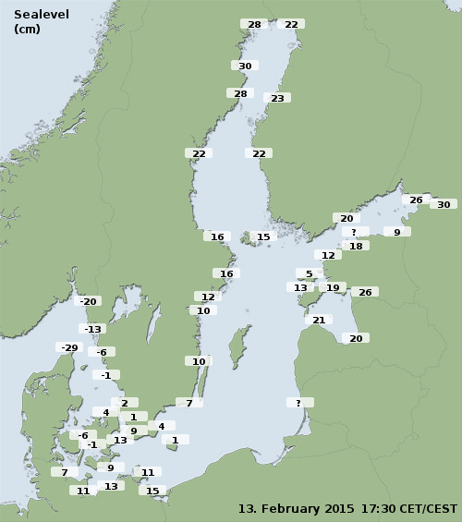
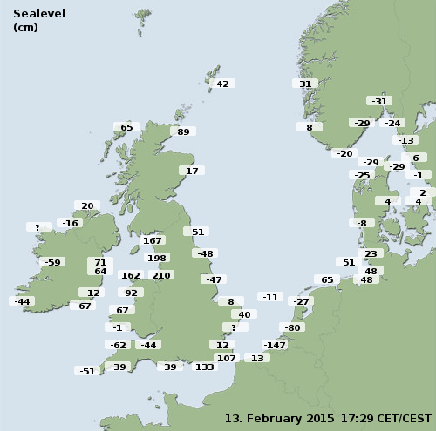
Sea level observation exchange
2x nine countries
boos.org
noos.bsh.de

Slide 3
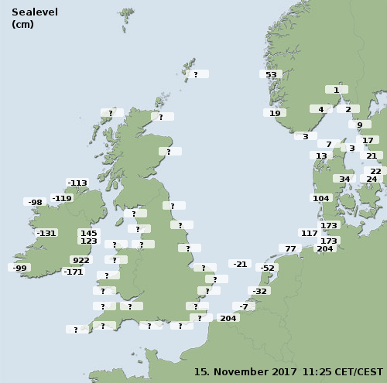
Sea level observation exchange

Slide 4
Issues
British data
  Decoding problem at DMI.
  Solved after last year’s meeting, but broken again ☹
  Hopefully solved permanently primo 2018
  Irish data
    ~ 1 month of downtime – ftp directory change
  French data
    no contact made yet
    Weekly monitoring set up

Slide 5
Sea level forecast exchange
Managed thru
ftp boxes
matroos

Slide 6
Issues / todo
Norwegian data
  Sea level forecast missing thru 2017. Solved.
  Dutch data
    New DSCM data source to be implemented
  Matroos
    Single point retrieval

Slide 7
The matroos forecast page is more complete.
We need to synchronize.

Slide 8
Storm surge warning -
Methodology
BSH: Skew surge
KNMI: Surge+astro tide
DMI: Sea level
Others: …
→ Even having the same model result, institutes will come up with different prediction of maximum sea level

Slide 9
BMA - Methodology
Synchronise with similar effort in BOOS.

