Slide 1


MME (Multi Model Ensemble) WG
Current developments in CMEMS-NOOS
Tabea Rebekka Panteleit, Stephan Dick

Slide 2
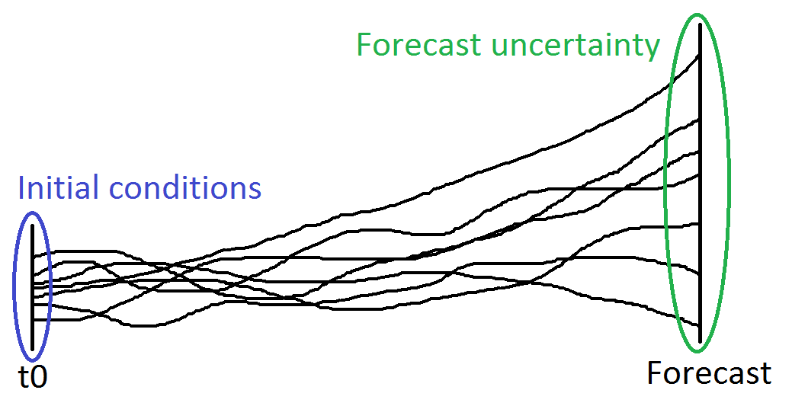
Multi-Model ensemble purpose
The MME shall provide the basis for the development of uncertainty estimates for all forecast products.
The MME system shall provide an estimate of the best overall forecast, i.e. have a reduced overall error compared to every single ensemble member.

Slide 3
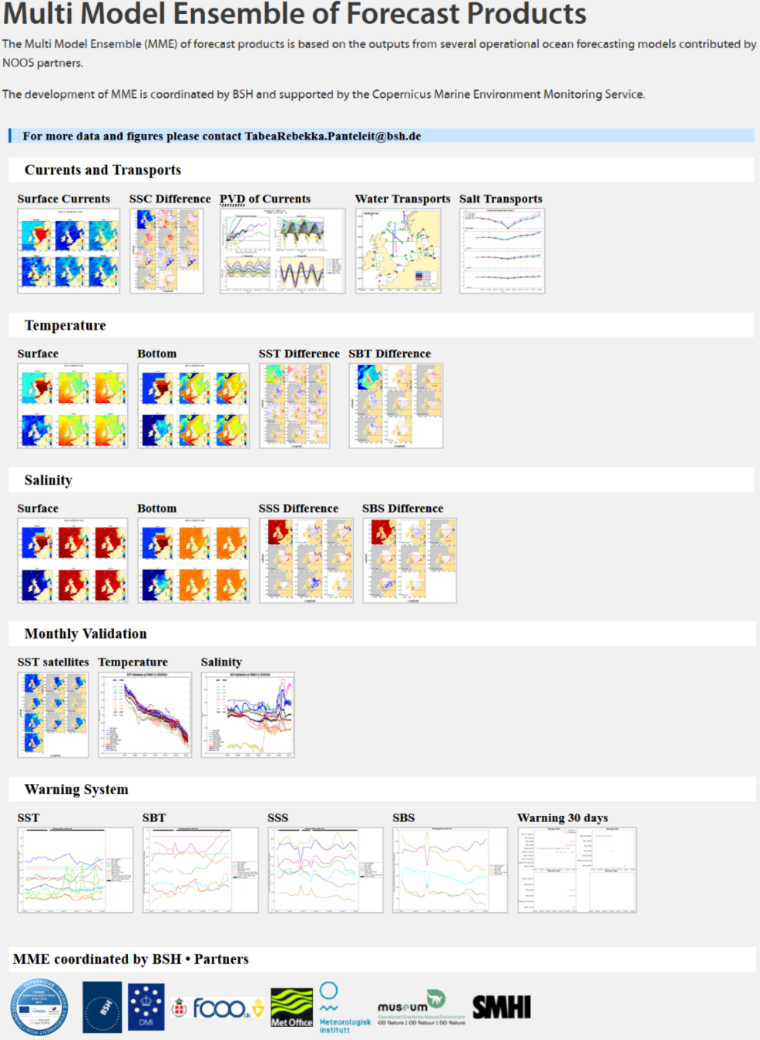
Multi-Model ensemble FC
Daily figures and data on NOOS website
Daily ensemble statistics of Temperature, Salinity, Currents and Transport
  Temporal / spatial distribution of forecast uncertainties
Monthly validation of T&S at observation stations and SST with satellite data
  Supplement to single-model validation
Warning system
  Detection of forecast products deviating strongly from MME

Slide 4
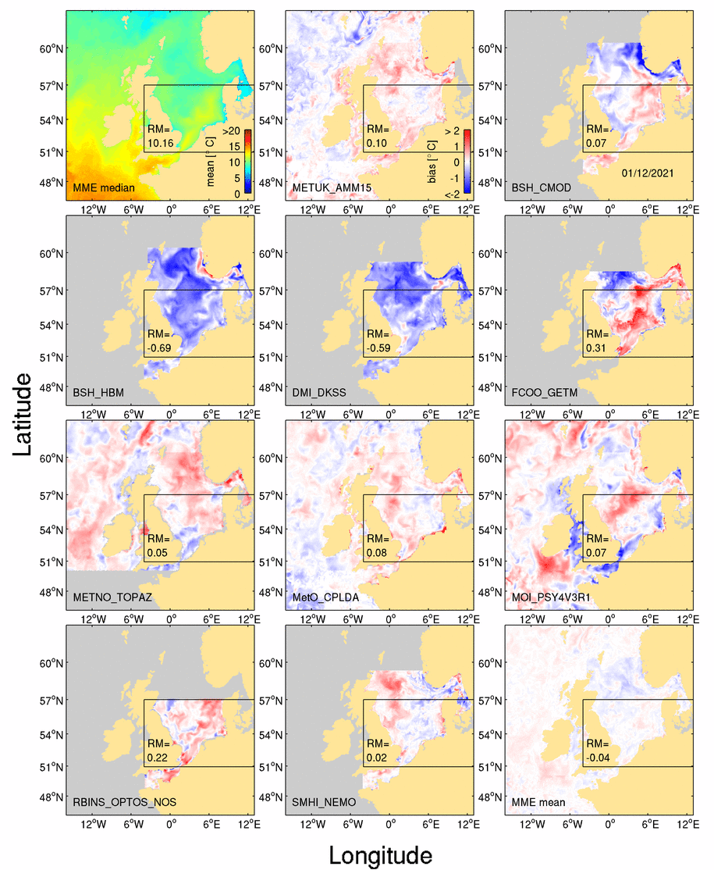
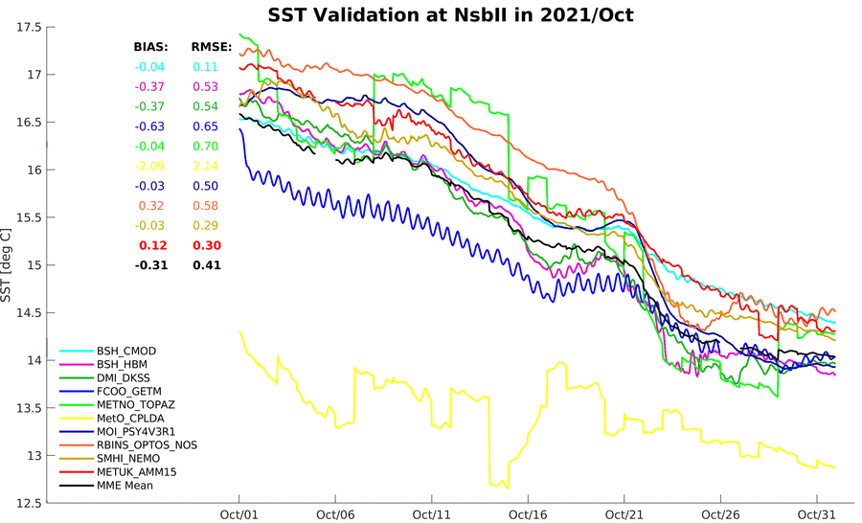
Multi-Model ensemble FC
Currently 10 models for SST
  Added two CMEMS models (CPLDA & PSY4V3R1) to MME FC
At least 5 models for all other variables
Ensuring operationality of Multi-Model Ensemble forecast products

Slide 5
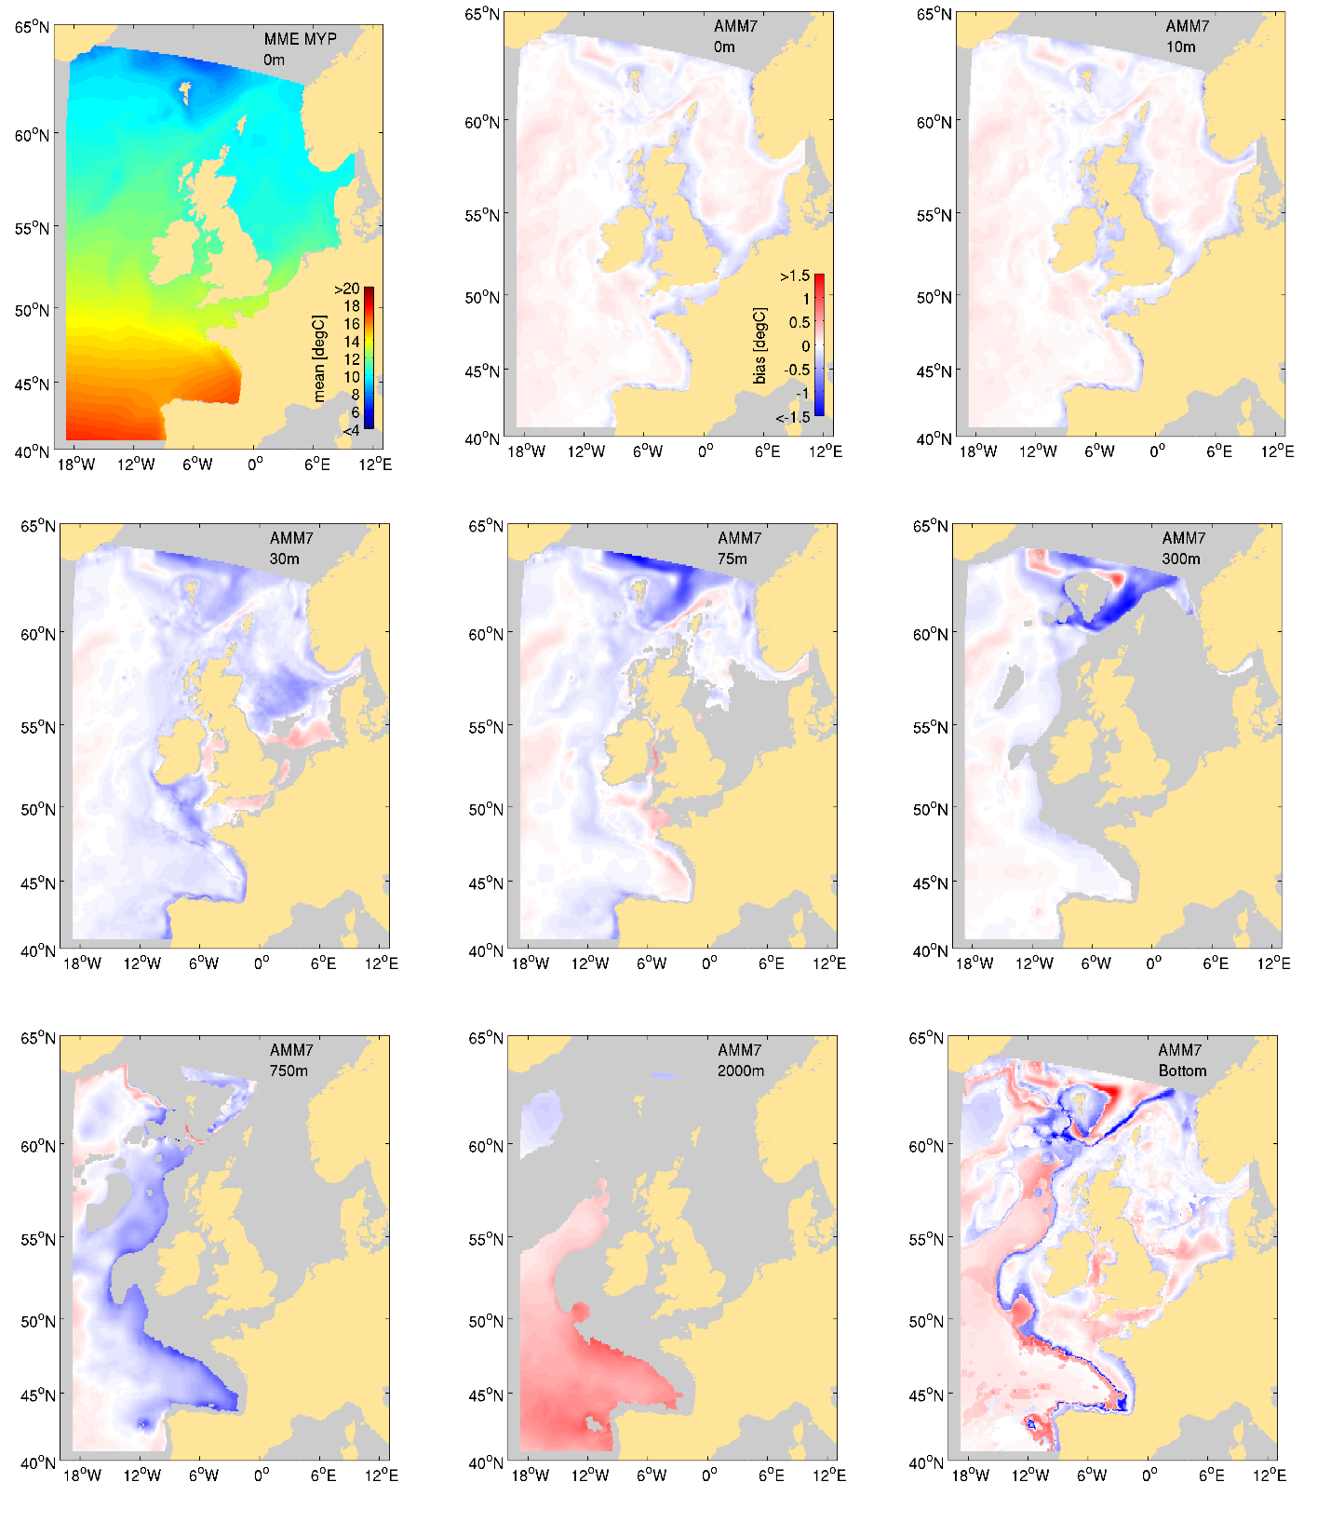
Multi-Model ensemble MYP
3 Reanalysis: GLO MFC (GLORYS12), IBI MFC (IBIRYS V3) and NWS MFC (AMM7 V5)
Monthly temperature and salinity fields
Determination of weighting factors is based on two datasets: KLIWAS North Sea climatology and CMEMS MultiObs Product
Extension of MME MYP from 1993-2019 is available as internal product in the CMEMS catalogue

Slide 6
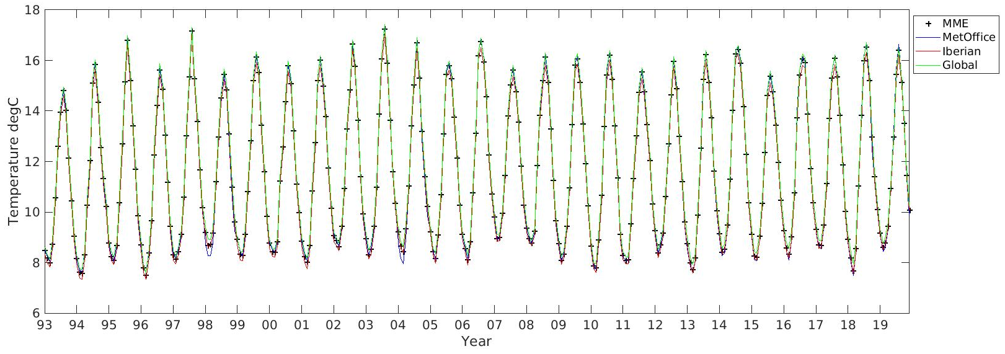
Multi-Model ensemble MYP

Slide 7
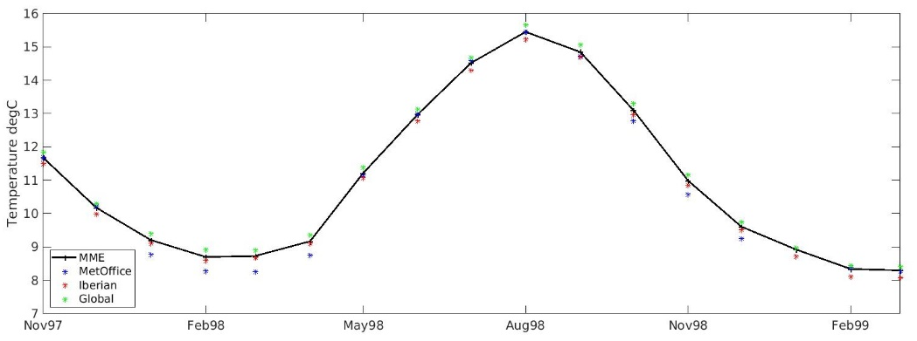
Multi-Model ensemble MYP

Slide 8
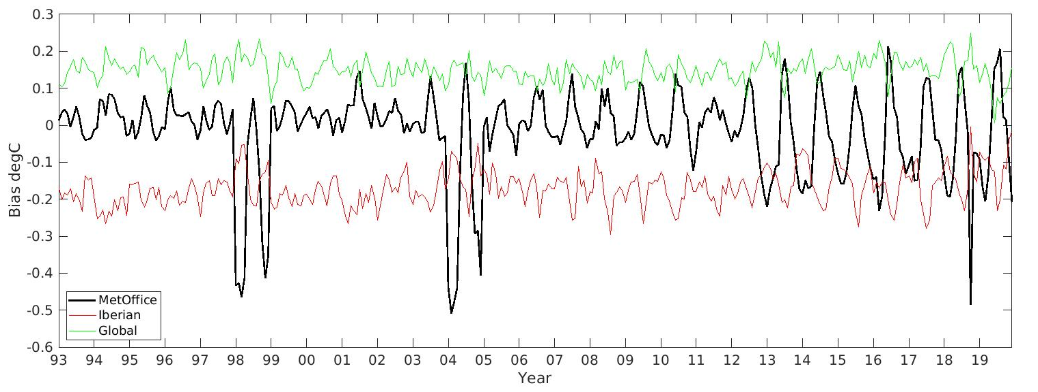
Multi-Model ensemble MYP
High negative bias in 1998 and 2004
Currently analysing the reasons
  Weighting method/MME?
  MetOffice-model?
Validation with observational data

Slide 9
Multi-Model ensemble - Outlook
Use warning system as an indicator for product incidents for the NWS NRT Product
Adding BGC variables to MME (Chl & O2)
→ Looking for further models (FC & MYP)
Development and testing of uncertainty estimates based on MME-NRT and MYP
Development and testing of intercomparison of CMEMS-MFCs with MME (BAL, NWS, GLO, ARC?, IBI?)
Adding BAL MFC reanalyses to MME MYP and expanding it with more models
Restructuring of NOOS-MME webpage

Slide 10
Multi-Model ensemble - Outlook
Thank you for your attention!

