Slide 1
DMI operational
+ two storm surges
Nov. 2017

Slide 2
Ocean models
HBM for circulation
WAM for waves
ERGOM for marine ecology
BSHdmod for drift simulations

Slide 3
Ult. 2016 - 2017
1/3 of staff lost.
Weather routeing CLOSED
Marine ecology CLOSED
Commercial activities LIMITED
Distant waters CLOSED
IT-support LIMITED&FORMALISED

Slide 4
2017-
Consolidation
Refinement of existing systems
New weather model
Ensembles
Climate Atlas and -adaptation

Slide 5
Numerical weather prediction
Future ocean model input
Hirlam → Harmonie non-hydrostatic resolution increase for cloudburst prediction ocean model re-calibration?
COMEPS ensembles combined Hir&Har
12 members each, 2 updated every hour

Slide 6
Circulation model
HBM
Mainly BSH/DMI effort
Very efficient HPC code
Two-way nesting for connected seas
Input: Hirlam+Ehype3

Slide 7
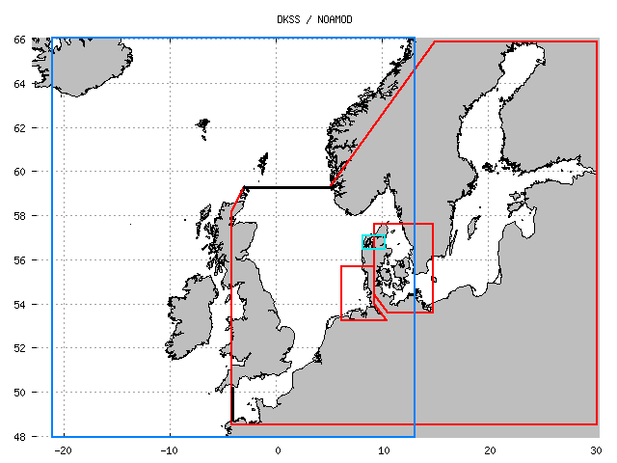
HBM / DKSS storm surge
For Copernicus, the Baltic is a separate high resolution domain
- and ERGOM is coupled

Slide 8
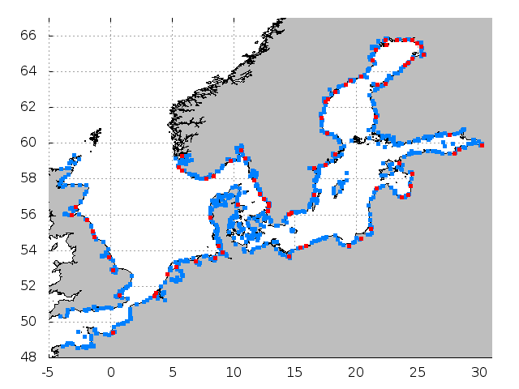
846 E-hype3 outlets

Slide 9
5 day forecast, 4x / day
Production time ~30 min at
DMIs CRAY-XC supercomputer cpu cost ~2.500 €/year

Slide 10
HBM development data assimilation using ICES profiles geographical refinements, fjords and narrows possible re-calibration with Harmonie wind ice model
Ensembles.
Feasible with half the forecast range.

Slide 11
The future will see a test of NEMO (NEMO-Nordic?), for strategic purposes

Slide 12
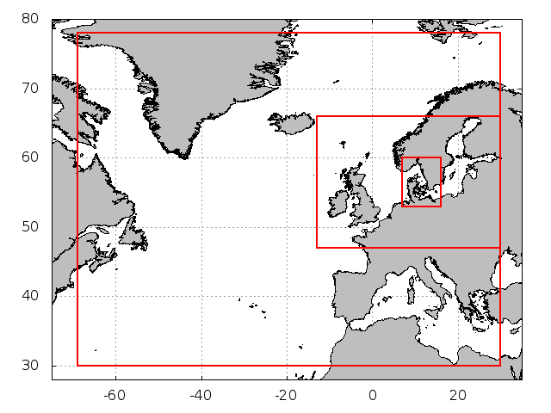
DMI-WAM
Nested cy4.5 set-up
25-5-1 km. Resolution doubled.

Slide 13
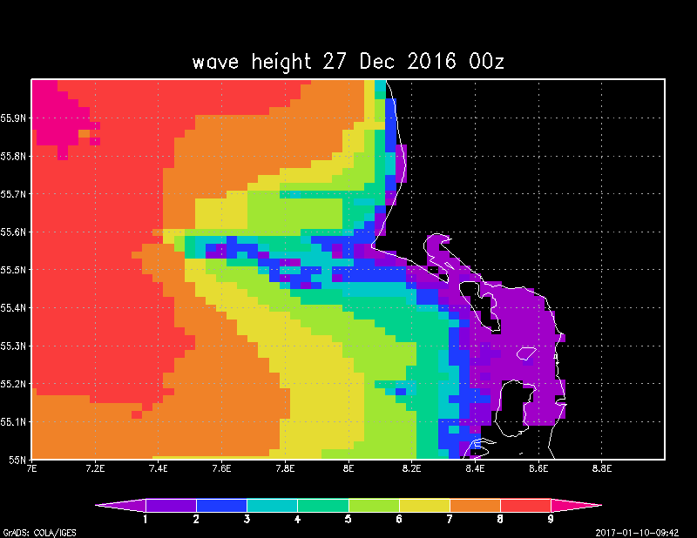
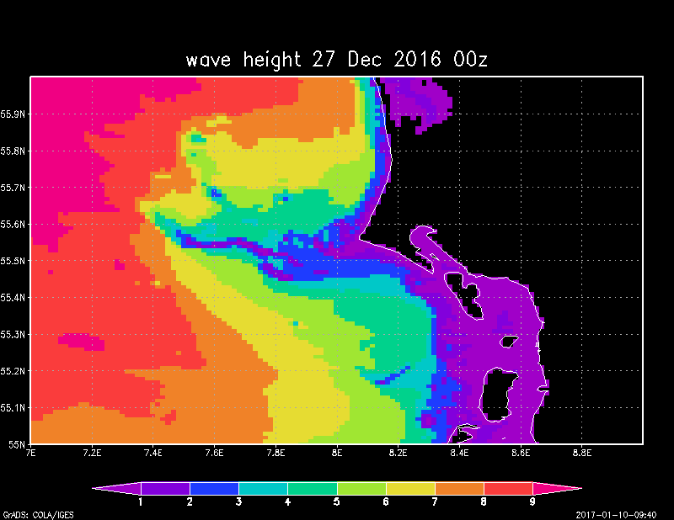
Spurious Ice ↑
½ nautical mile WAM
Horns Rev

Slide 14
Greenland-Arctic: pre-operational, wam cy4.5.4 gaussian grid
5 km coastal, OSISAF ice
Ensemble: pre-operational, 11 members
5km Hirlam & coarse WAM
Mediterranean, Red Sea, …
CLOSED

Slide 15
Marine ecology
For Copernicus
In collaboration with BSH.
Interfacing work (I and O)
Drift model
Static.

Slide 16
Storm surges
Silent Surge, Jan 2017
Ingolf, Oct 2017

Slide 17
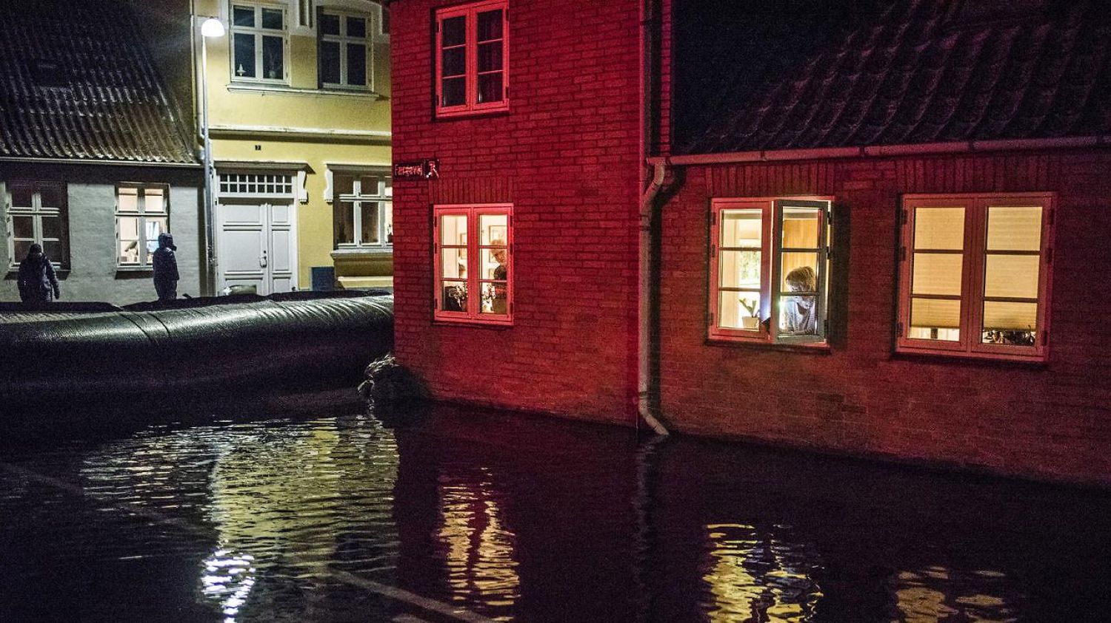
”Silent Surge”, Jan 4th 2017

Slide 18
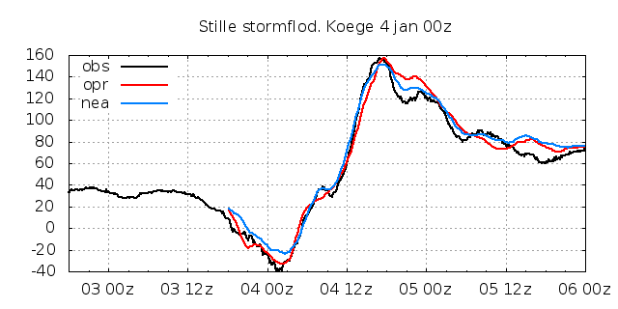
Requested: 10cm accuracy
Delivered: 10% accuracy

Slide 19
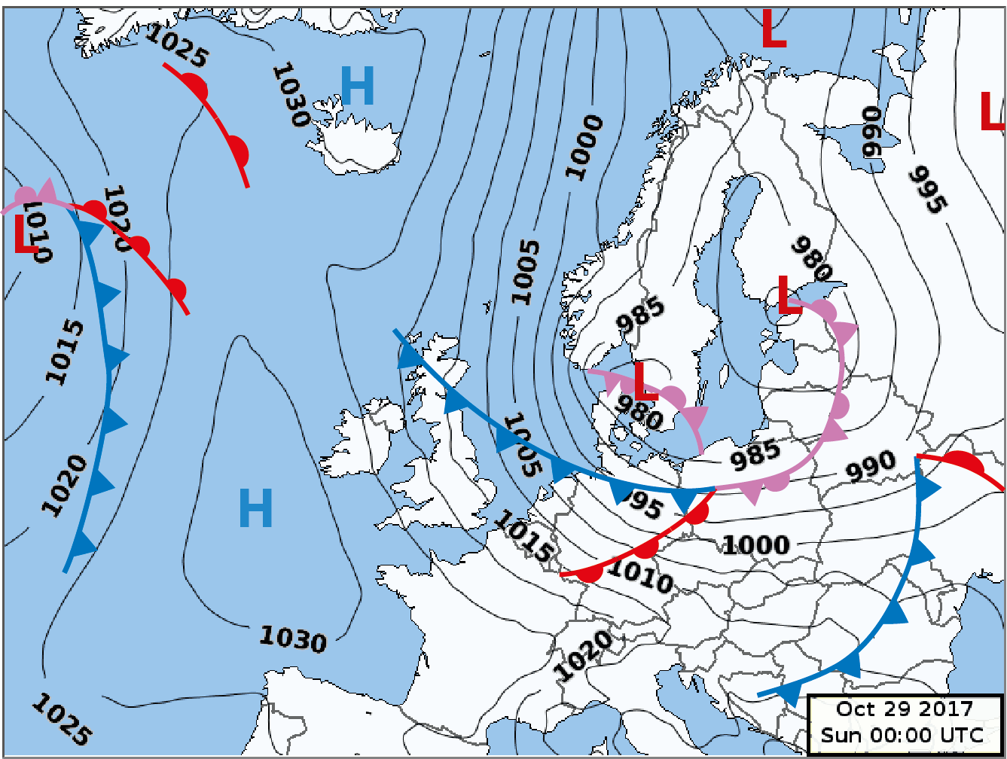
Study: Ingolf Oct 28-29th

Slide 20
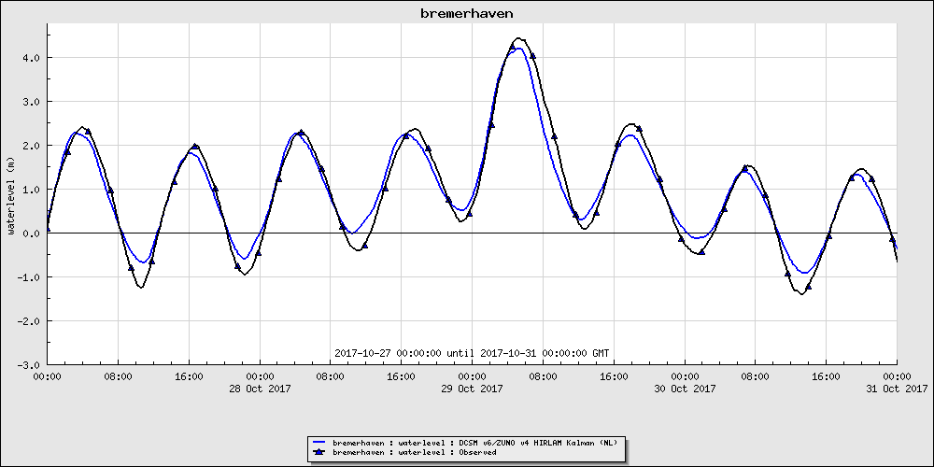
Ingolf in Bremerhaven
HW= 4,43m Oct 29th 0515

Slide 21
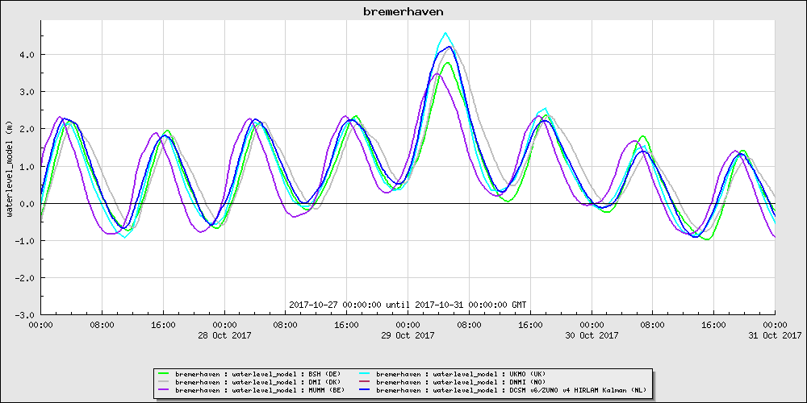
Ingolf in Bremerhaven
NOOS sea level hindcasts

Slide 22
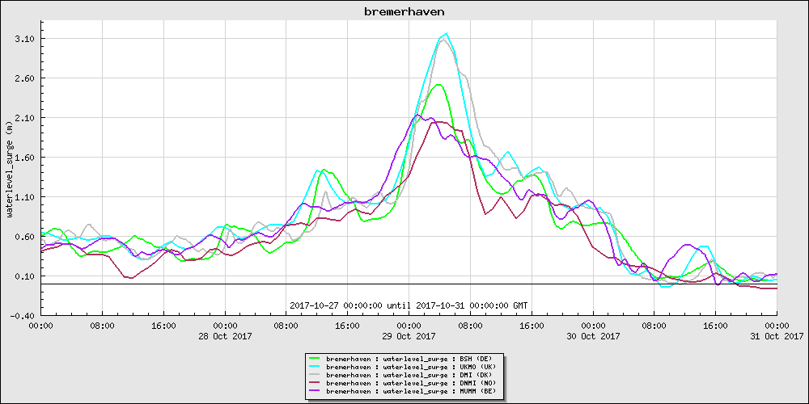
Ingolf in Bremerhaven surge = modelled sea level – modelled tide

Slide 23
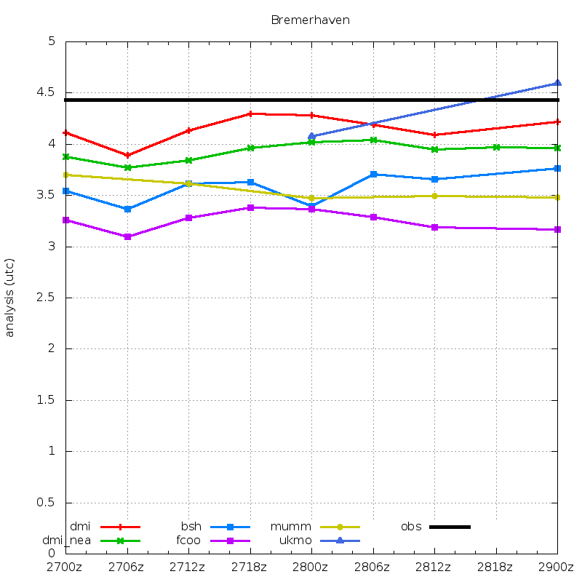
Ingolf in Bremerhaven.
Predicted HW (met.no, knmi missing)

Slide 24
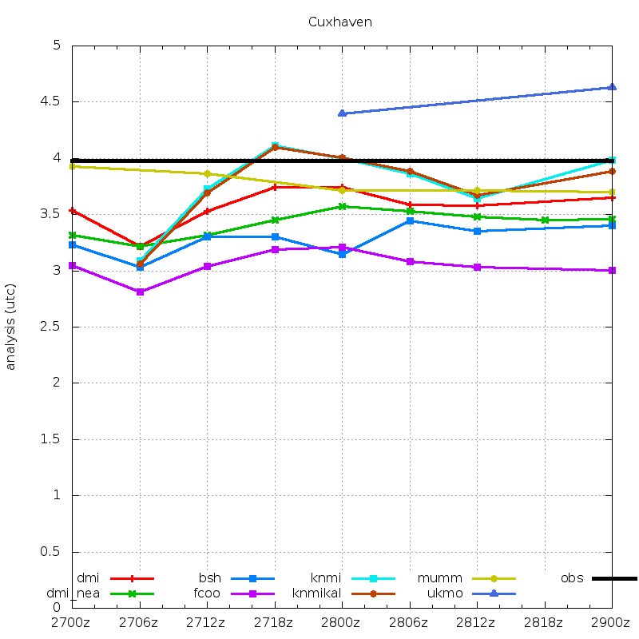
Ingolf in Cuxhaven
Predicted HW (met.no missing, fixed)

Slide 25
Ingolf in Bremerhaven and Cuxhaven
Observed and modelled HW
Bremerhaven 4.43 hindcast 3.2-4.6m
Cuxhaven 3.98 hindcast 3.0-4.6m
Quality largely unchanged since 36 hours in advance.

